Slide 1


Slide 2
Who Broke the Economy 2.0
Pop Quiz
- - - - - - - - - - - - - - - - - - - - - - - - - - - - - - - - - - - -

Slide 3
What percentage of private sector workers in the U.S. has a union job?
A. 0%
B. 7%
- - - - - - - - - - - - - - - - - - - - - - - - - - - - -
C. 33%
D. 50%

Slide 4
Private Sector Union Density
33%
1955
7%
2011

Slide 5
In the United States, how much more money does the average CEO make than the average worker?
A. 50 times
B. 96 times
- - - - - - - - - - - - - - - - - - - - - - - - - - - - -
C. 178 times
D. 343 times

Slide 6


Average CEO pay
- - - - - - - - - - - - - - - - - - - - - - - - - - - - -
343
25
times higher than the average worker

Slide 7
EBay paid CEO John Donahoe $12.4 Million last year.
How much did EBay pay in federal taxes?
A. $0
B. $11 Million
- - - - - - - - - - - - - - - - - - - - - - - - - - - - -
C. $12 Million
D. $100 Million

Slide 8


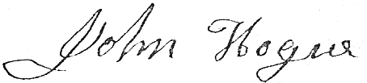
United States of America
Tax Refund 2010
Pay to the Order of:
EBay
. . . . . . . . . . . . . . . . . . . . . . . . . . . . . . . . . . . . . . . . . . . . . . . . . . . . .
Pay the Amount of:
One Hundred and Thirty One Million Dollars --------
$131 million

Slide 9
In the $2.5 Billion debt ceiling compromise…
A. $0
how much of the deficit reduction comes from closing corporate tax loopholes?
B. $1.4 Billion
- - - - - - - - - - - - - - - - - - - - - - - - - - - - -
C. $35 Million
D. $900 Million

Slide 10
How many jobs will be lost as a result of the recent debt ceiling deal?
A. 100,000
B. 650,000
- - - - - - - - - - - - - - - - - - - - - - - - - - - - -
C. 700,000
D. 1.8 Million

Slide 11
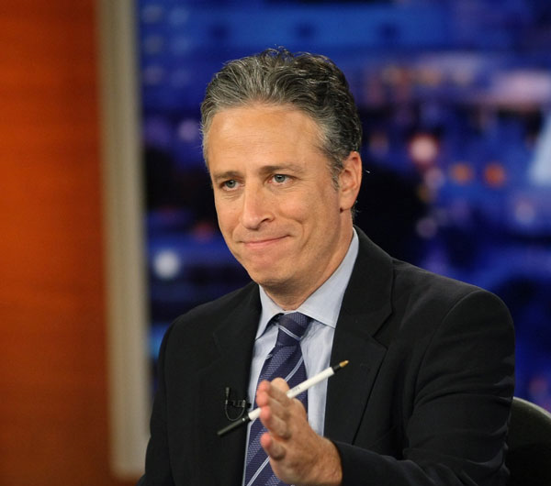
Jon Stewart
The Daily Show

Slide 13
The national deficit makes up a bigger part of our economy than ever before.
true
- - - - - - - - - - - - - - - - - - - - - - - - - - - - -
false

Slide 14
As a share of our Gross Domestic Product (GDP)…
Our national deficit was higher following WW II than it is today.
$
+
$
$
- - - - - - - - - - - - - - - - - - - - - - - - - - - - - - - - - - - - - - - - -
$
-
1945
2011
Notes:
Gross Domestic Product (GDP) refers to the refers to the market value of all final goods and services produced in a country in a given period. GDP per capita is often considered an indicator of a country’s standard of living.

Slide 15
Adding enough jobs to shrink unemployment by 1%, would reduce our deficit by $140 billion.
true
false
- - - - - - - - - - - - - - - - - - - - - - - - - - - - -

Slide 16
$
$
$
$
$
$
$
$
$
$
Deficits
$
$
$
$
$
Unemployment
$
$
$
$
$
$
$
$
$
Jobs
Revenues
$
- - - - - - - - - - - - - - - - - - - - - - - - - - - - - - - - - - - - - -
Unemployment
Deficits
- 1%
- $140Billion
Job Creation Reduces Deficits
Notes:
Right now the United States faces high unemployment and high federal deficits. What’s the best way to change this situation? Give more tax breaks to the rich? If that were going to really create more jobs, wouldn’t that have already happened by now?
If we create enough jobs to reduce unemployment by just 1%, we can reduce our deficit by $140 Billion. Why is that?
When workers get jobs, they get paid. Then they start spending more money in their communities, which means businesses do better as well. Workers and businesses start paying more local, state and federal taxes based on their increased earned income and profits. That’s how we reduce the deficit and start to actually build revenues. Revenues, for example, that can be invested back into our communities through infrastructure projects.

Slide 17
If we end the Bush tax cuts for the rich…
A. $40 Billion
how much can we invest in fixing our crumbling infrastructure?
B. $70 Billion
- - - - - - - - - - - - - - - - - - - - - - - - - - - - -
C. $700 Billion
D. $4 Trillion

Slide 18

$700 Billion is wasted on the rich when it could be invested in our roads and bridges

Slide 19
How many jobs could we create with that $700 Billion in infrastructure investment?
A. 50,000
B. 3.8 Million
- - - - - - - - - - - - - - - - - - - - - - - - - - - - -
C. 12.6 Million
D. 700 Billion

Slide 20

jobs
12.6 Million jobs could be created...
if we ended the Bush tax cuts for the rich.
jobs
jobs
jobs
jobs
jobs
jobs
jobs
jobs
jobs
jobs
jobs
jobs
jobs
jobs
jobs
jobs
jobs
jobs
jobs

Slide 21
Which president did the most to deregulate investment banks, enabling them to crash the economy?
A. George W. Bush
B. Ronald Reagan
- - - - - - - - - - - - - - - - - - - - - - - - - - - - -
C. 1st George Bush
D. Bill Clinton

Slide 22
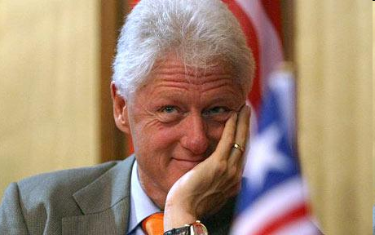

Slide 23
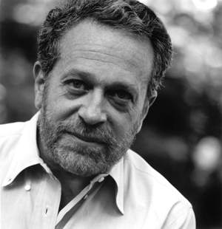
Robert Reich
Economist
Former U.S. Labor Secretary

Slide 24


